Slide 1
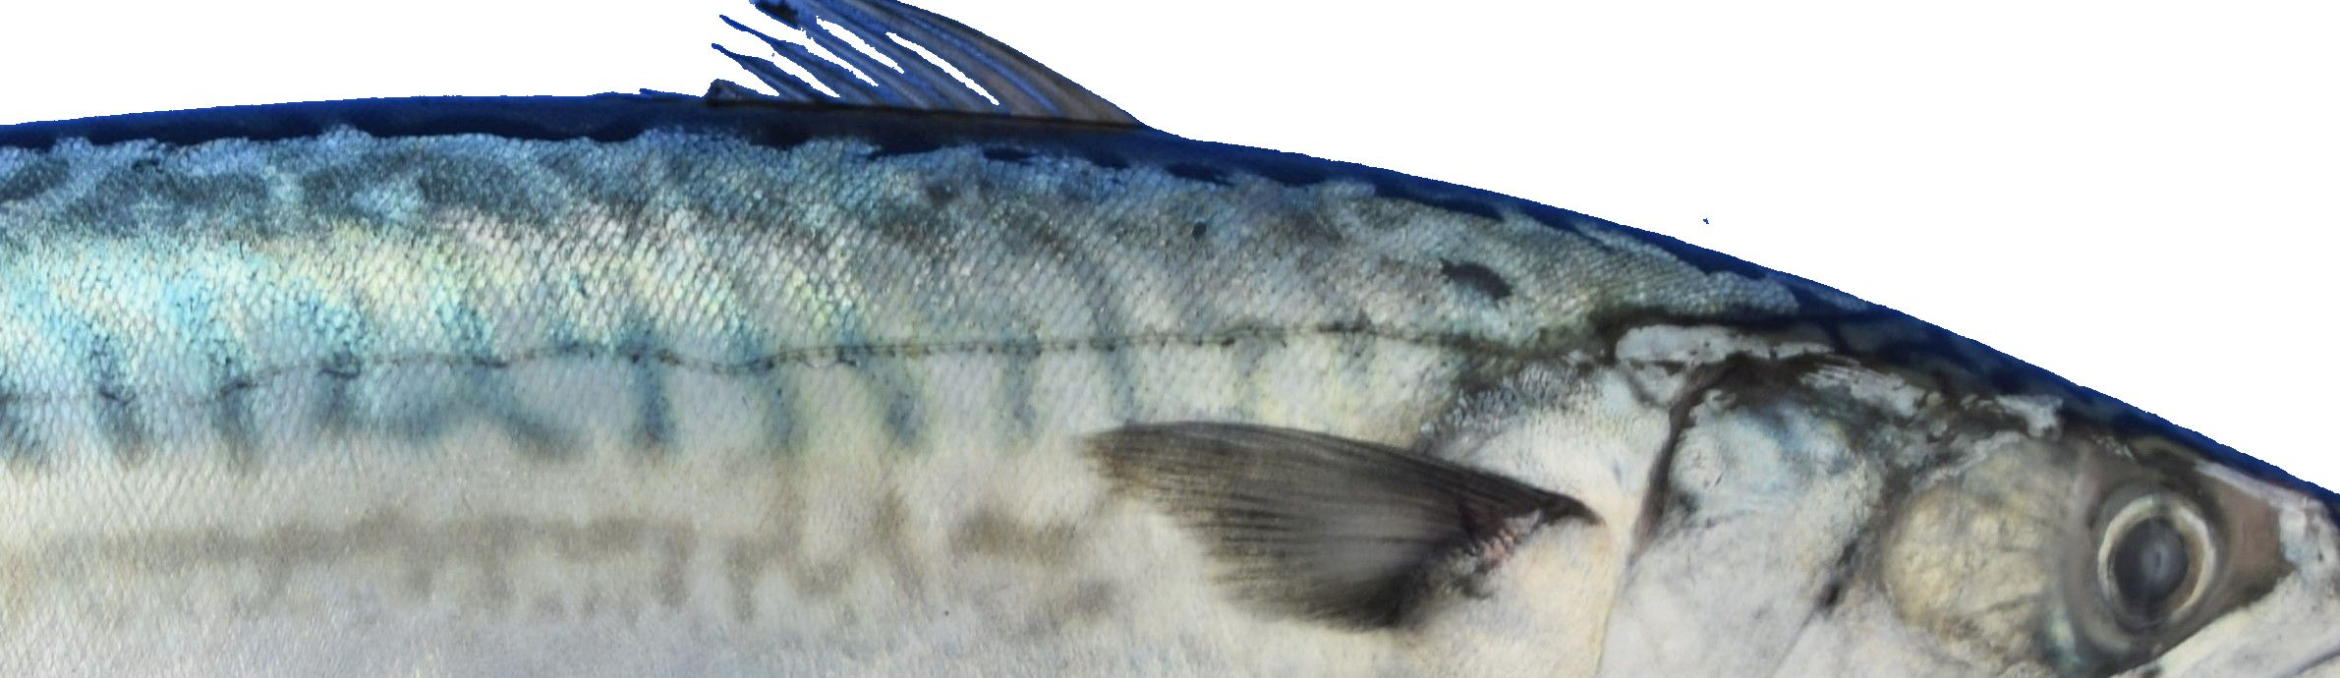
Pelagic species in the Northeast Atlantic
Martin Pastoors
Global Pelagic Forum, 24 April 2023, Barcelona

Slide 2
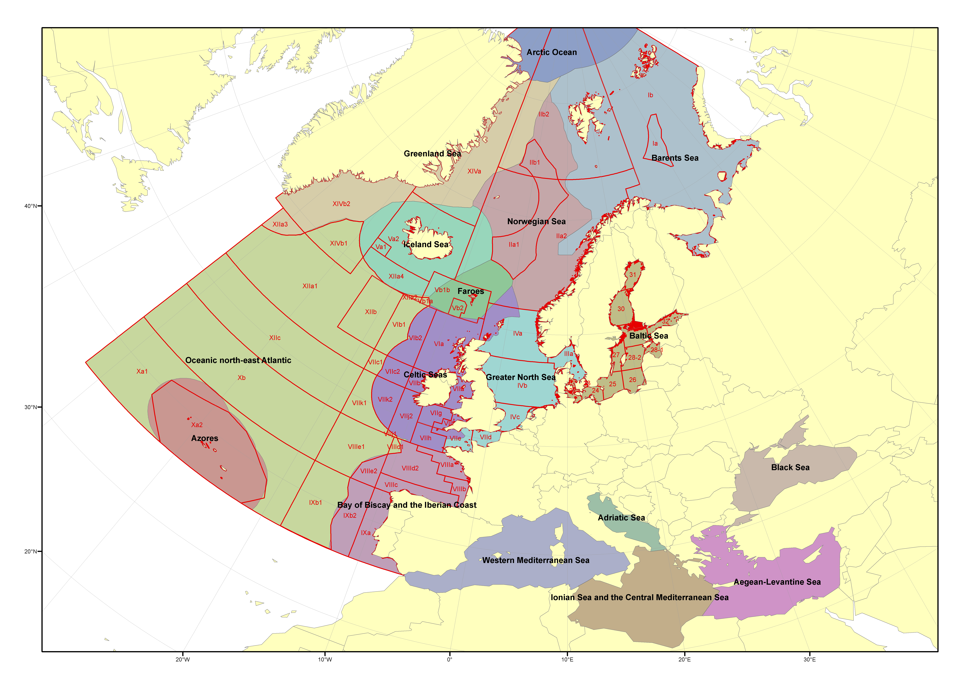
Context of scientific advice in the NE Atlantic
Scientific advice by International Council for the Exploration of the Sea (ICES)

Slide 3
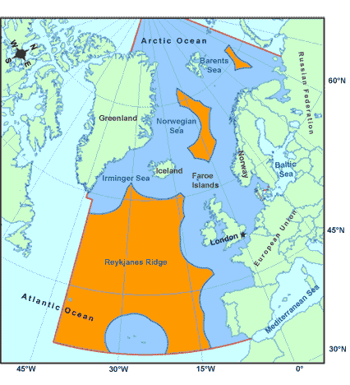
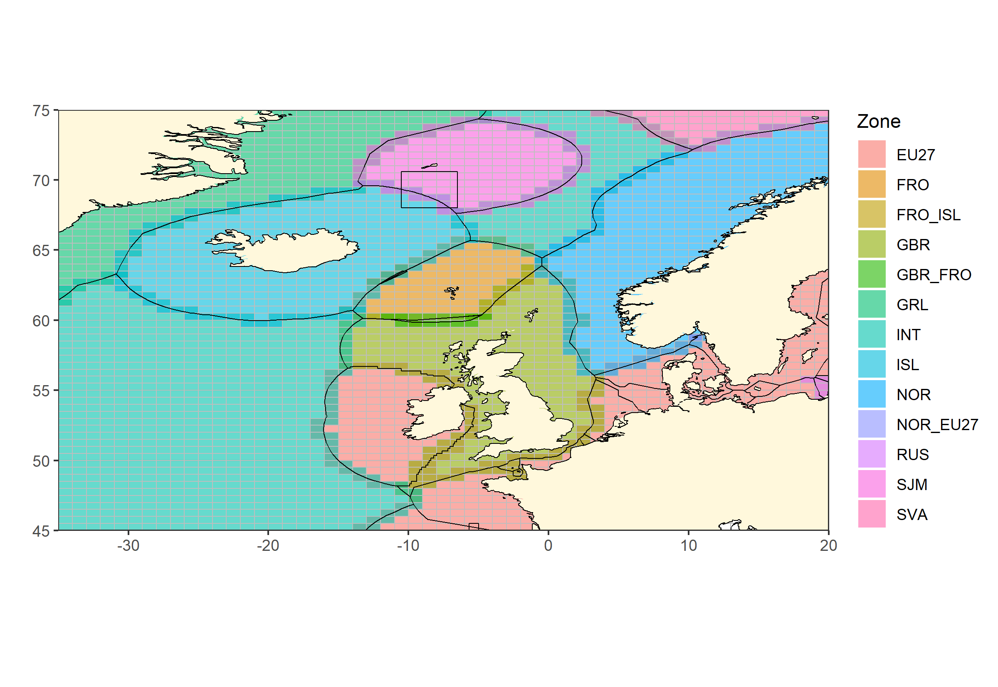
Fisheries management in the NE Atlantic
Northeast Atlantic Fisheries Commission (NEAFC)
Coastal States negotiations

Slide 4
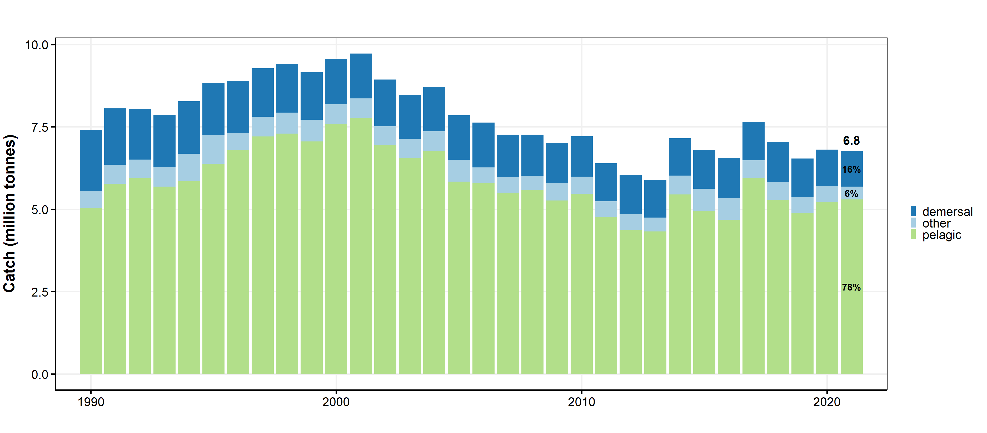
Catches of pelagic, demersal and other stocks

Slide 5
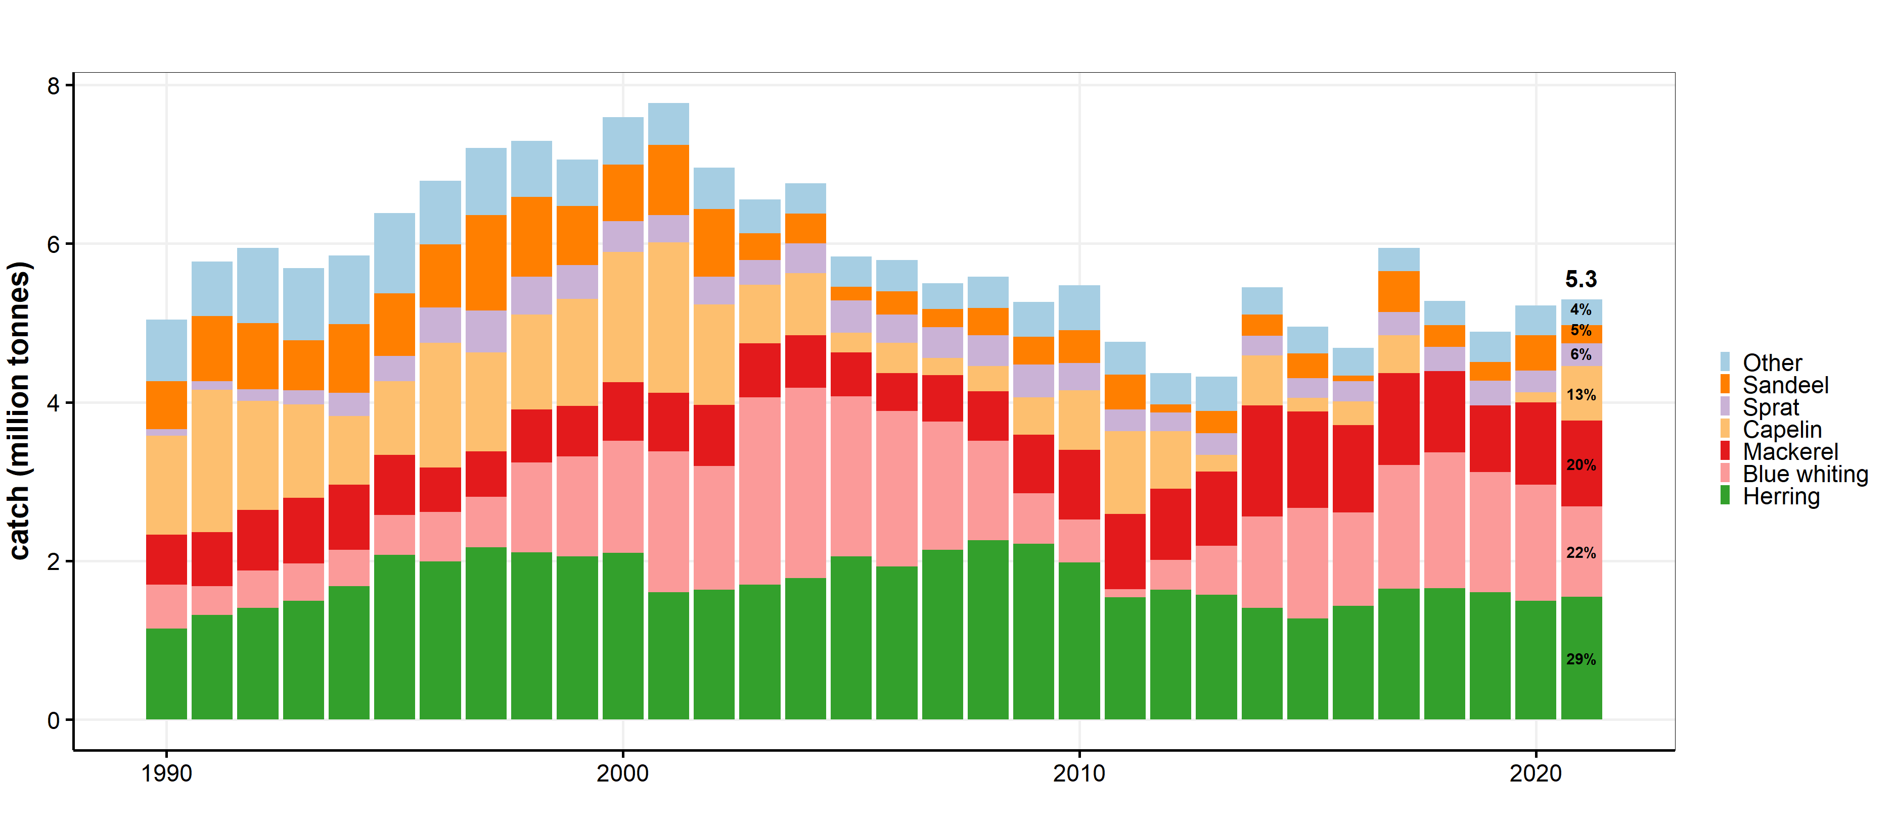
Catches of pelagic species

Slide 6
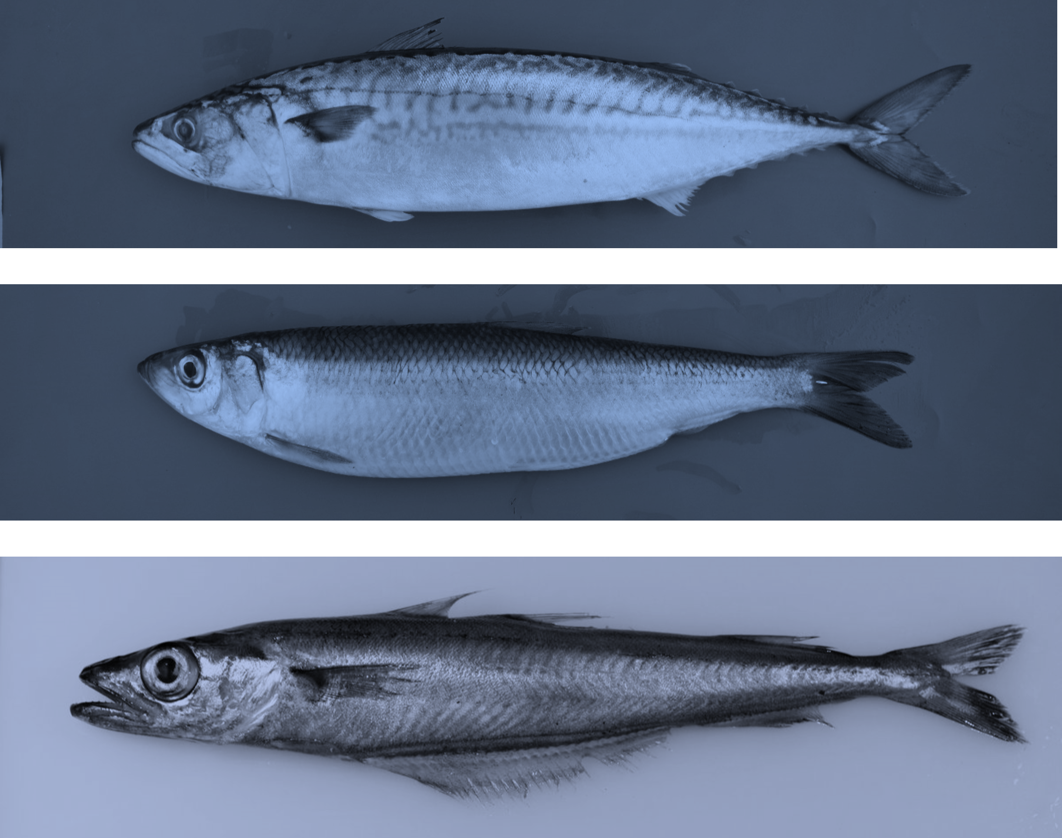
Species
Atlantic mackerel (MAC)
Scomber scombrus
Atlantic herring (HER)
Clupea harengus
Blue whiting (WHB)
Micromesistius poutassou

Slide 7
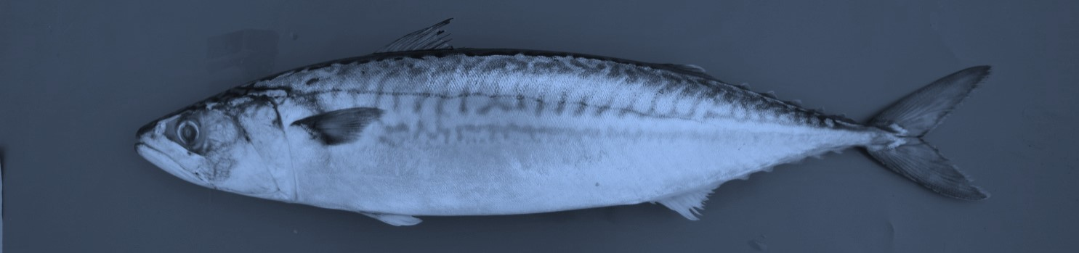
Atlantic mackerel (MAC)

Slide 8
Key aspects of Northeast Atlantic mackerel
Catch area has expanded, and is contracting
No agreement on sharing. Large overshoot catch over advice
High recruitment, but stock coming down
Very uncertain assessment
Advice for 2023 slightly lower than advice 2022

Slide 9
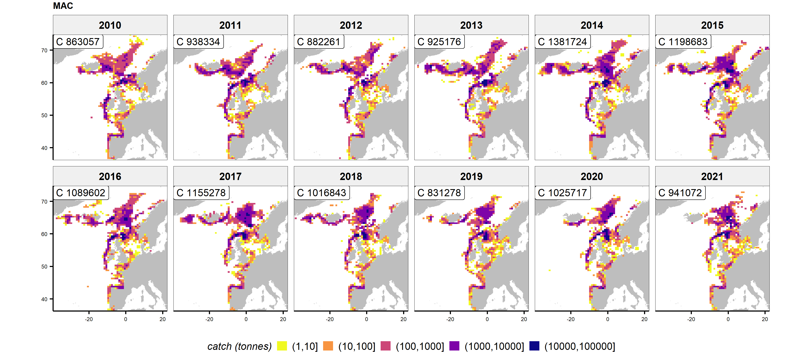
Mackerel: catch area expanding and contracting

Slide 10
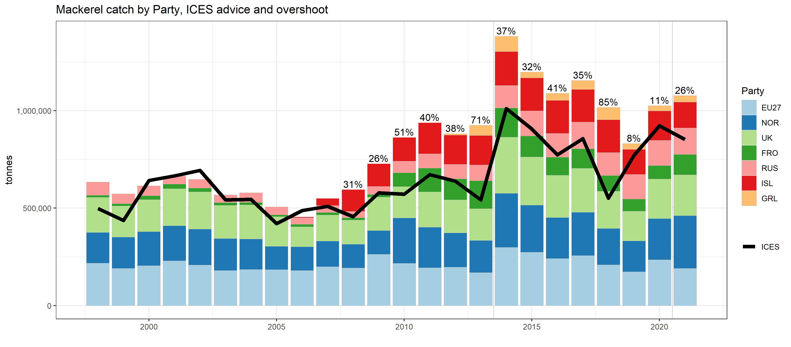
Mackerel: overshoot of catches over advice

Slide 11
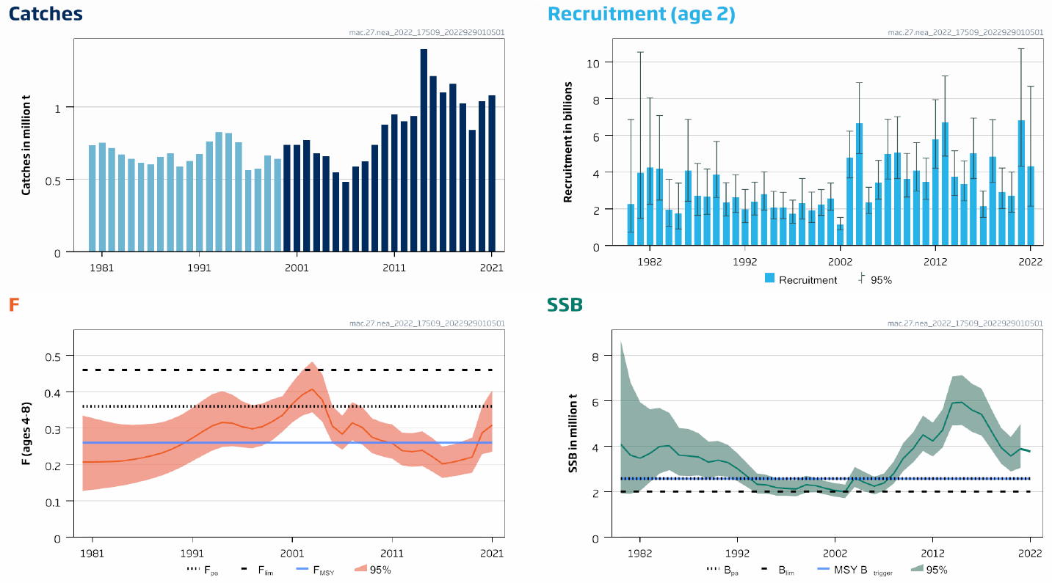
Mackerel: high recruitment, stock coming down

Slide 12
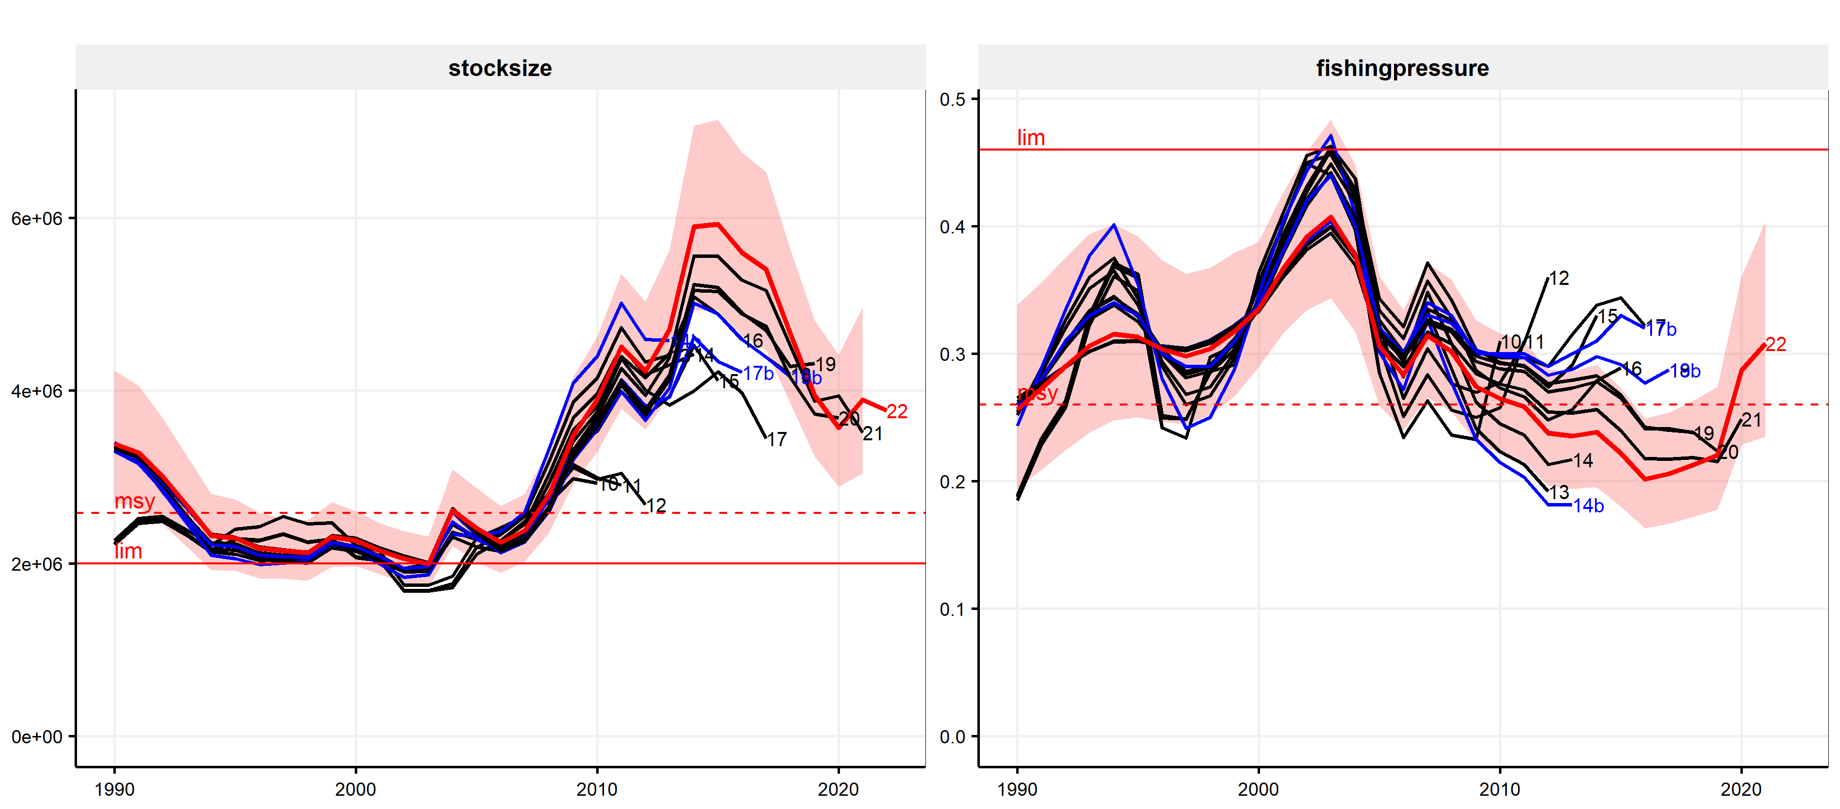
Mackerel: very uncertain assessment

Slide 13
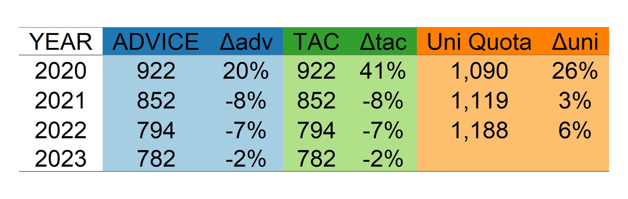
Mackerel: recommended (slightly) lower catch

Slide 14
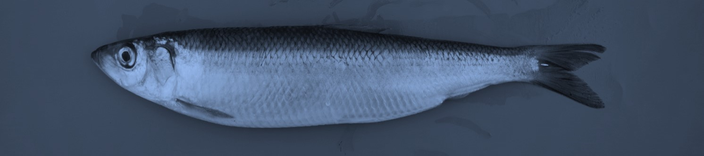
Atlantic herring (HER)

Slide 15
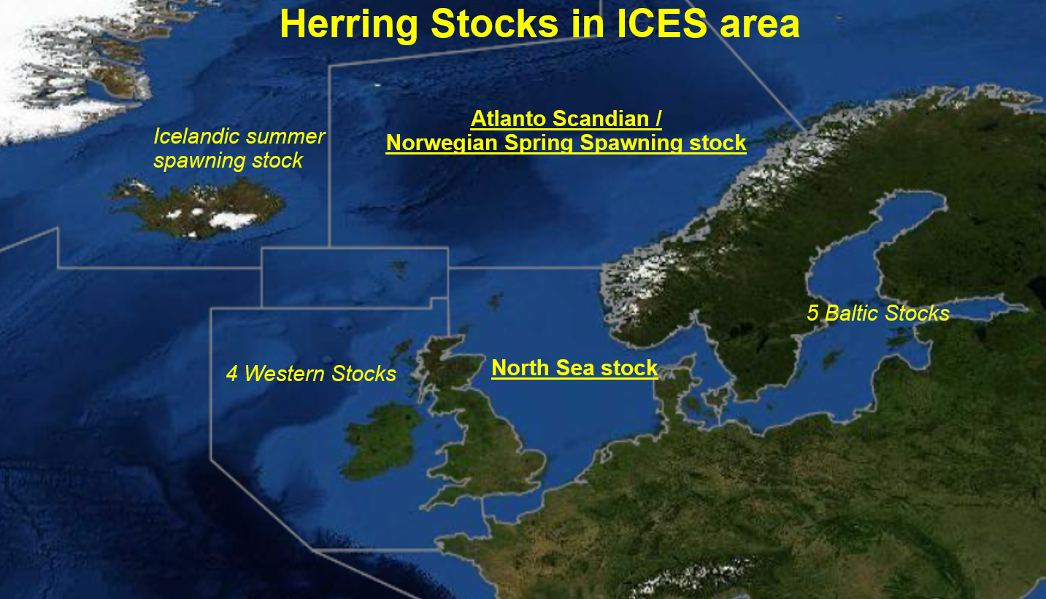

Slide 16
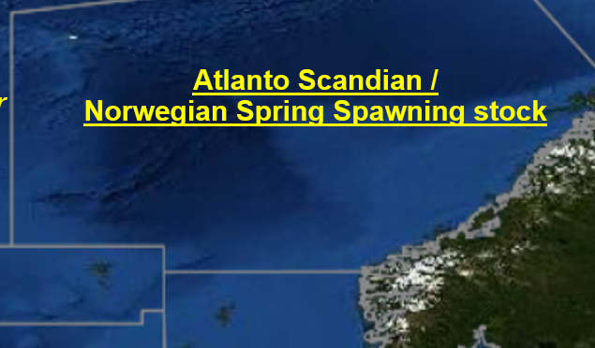
Key aspects of Atlanto-scandian (AS) herring
Catch area seems to be contracting
No agreement on sharing; some overshoot over advice
Stock declining, despite strong year class
Relatively consistent assessment
Advice 2023 15% lower than for 2022

Slide 17
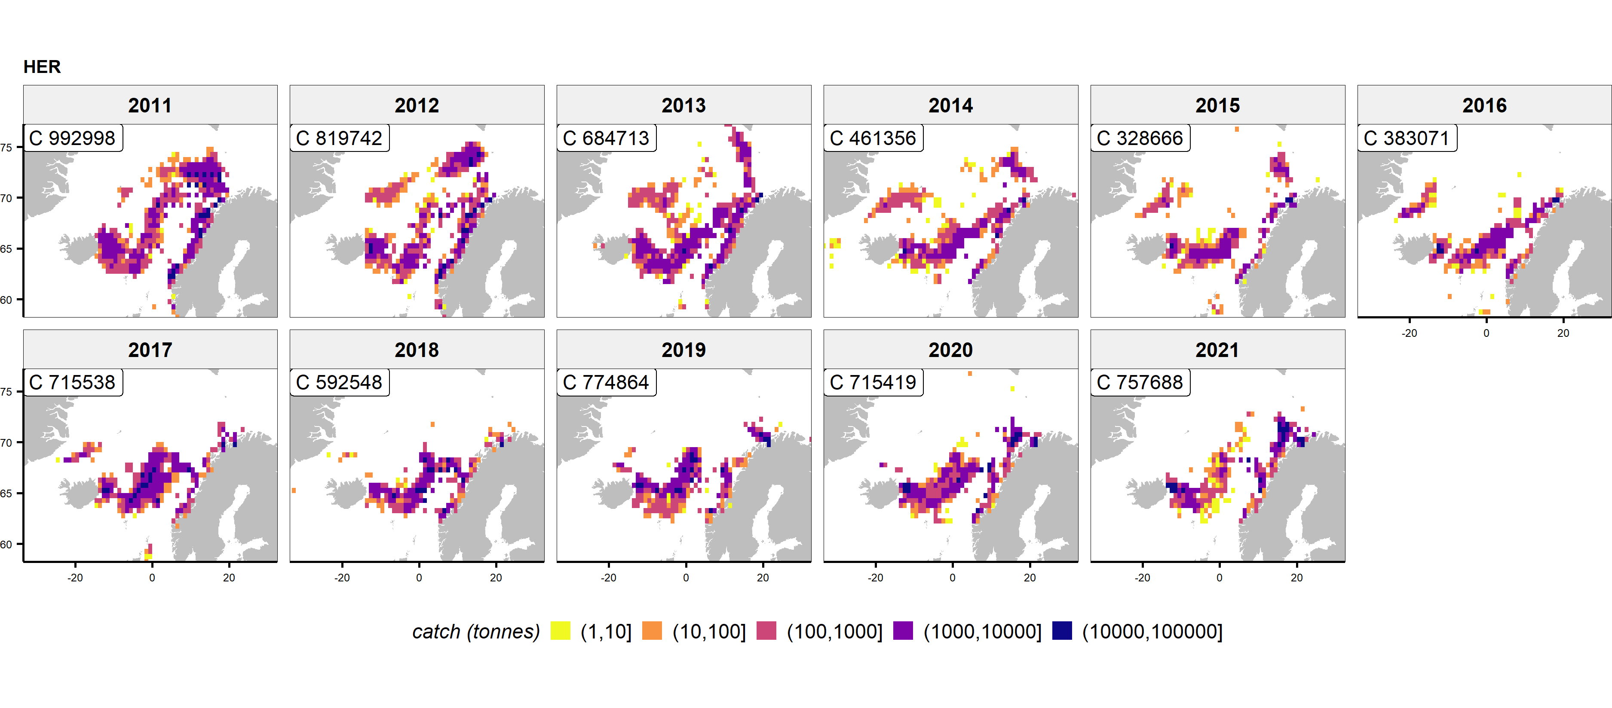
AS herring: contracting catching area

Slide 18
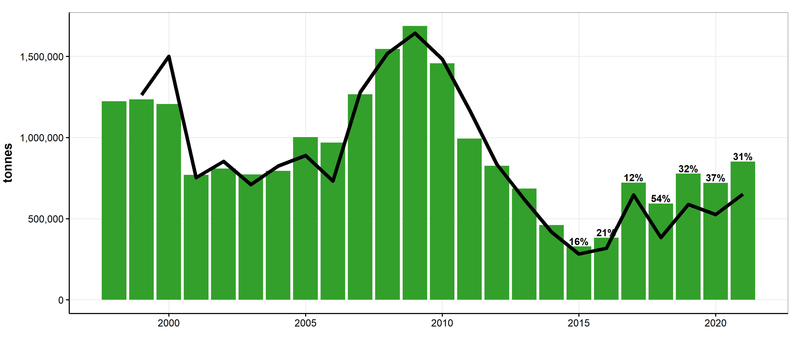
AS herring: some overshoot of catches over advice

Slide 19
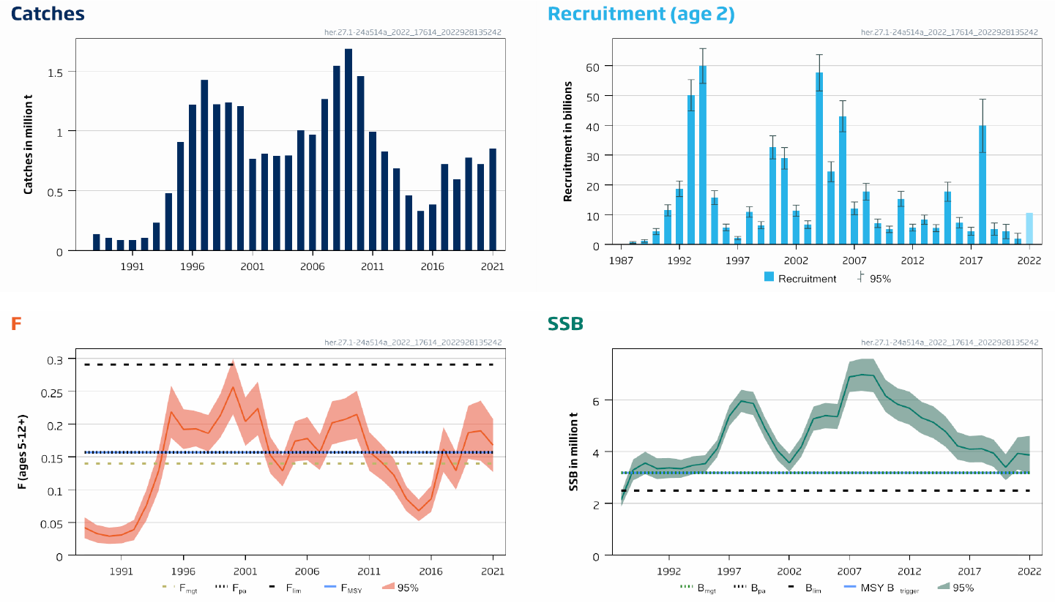
AS herring: stock declining

Slide 20
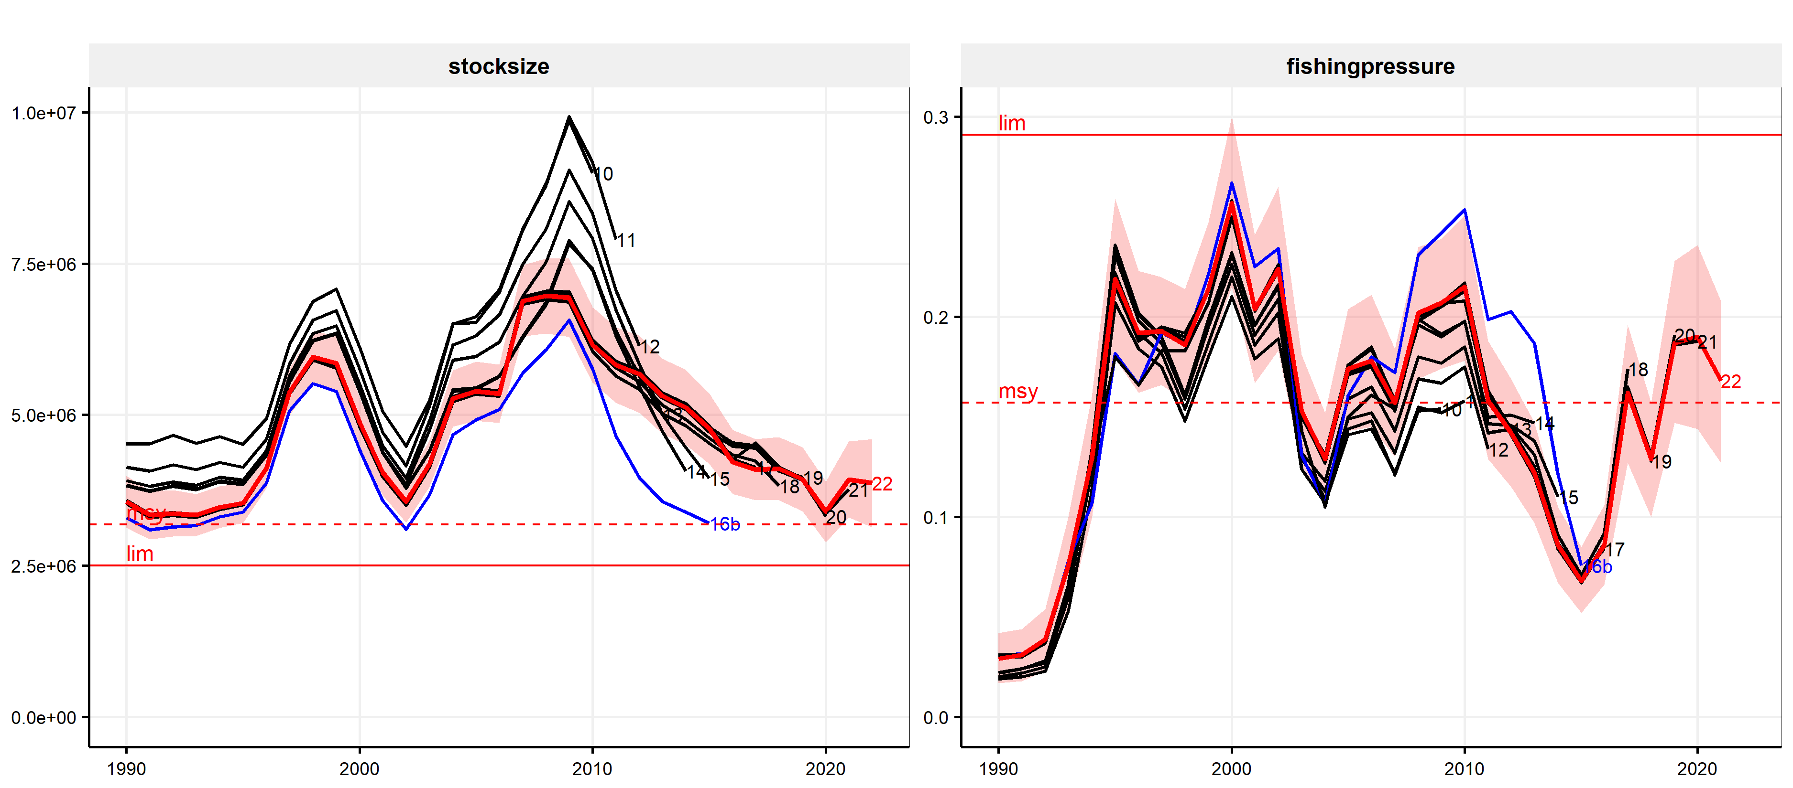
AS herring: relatively consistent assessment

Slide 21
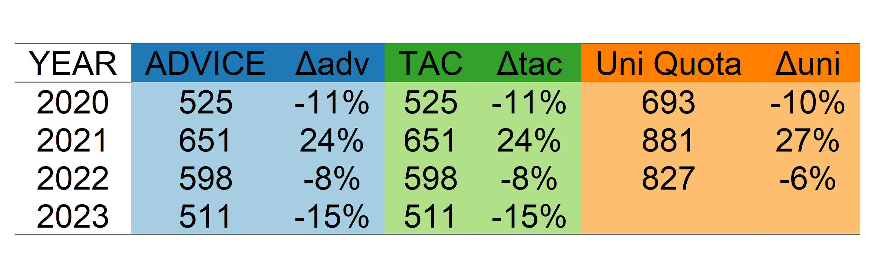
AS herring: 15% lower advice

Slide 22
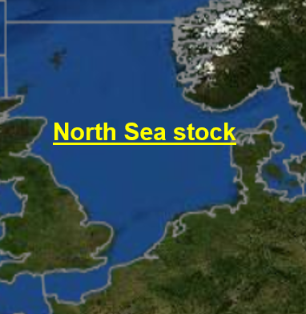
Key aspects of North Sea herring
Some mismatch between TAC and stock area
Stock coming down (close to trigger biomass)
Uncertainty in stock level in assessment (scaling)
Stable spatial patterns in catches
Advice for 23% reduction (relative to high advice 2022)

Slide 23
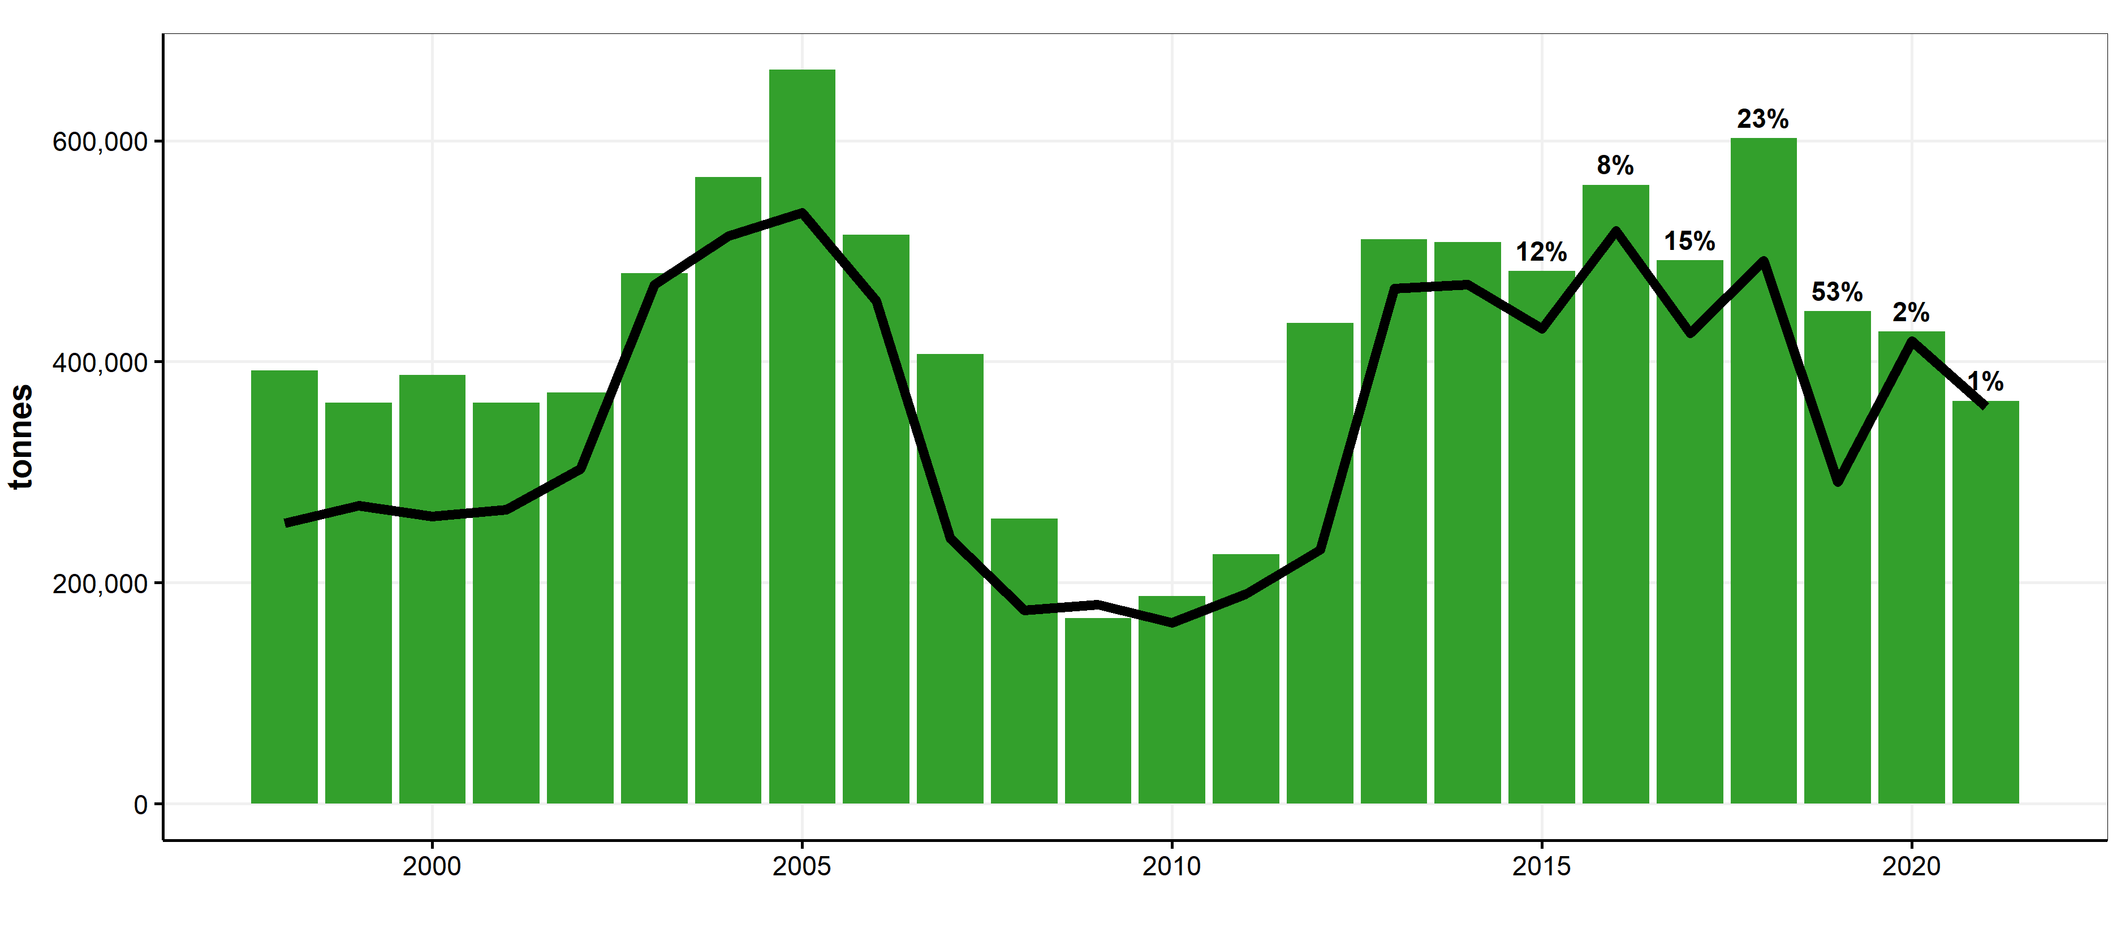
NS herring: catch over advice (mismatch)

Slide 24
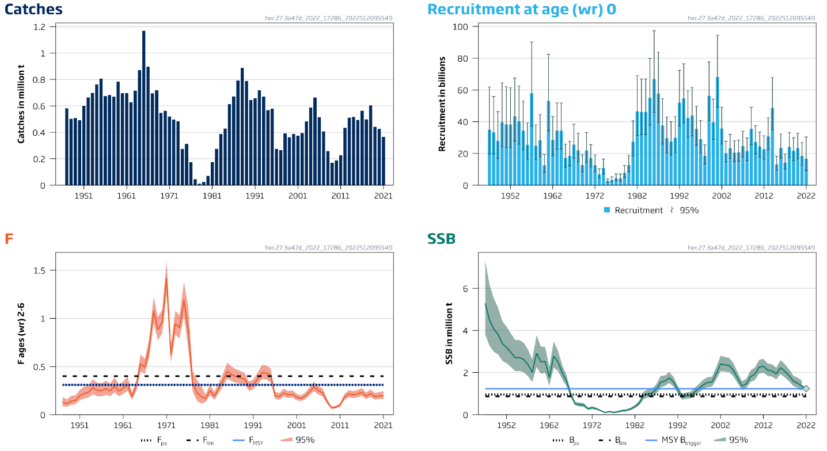
NS herring: stock coming down

Slide 25
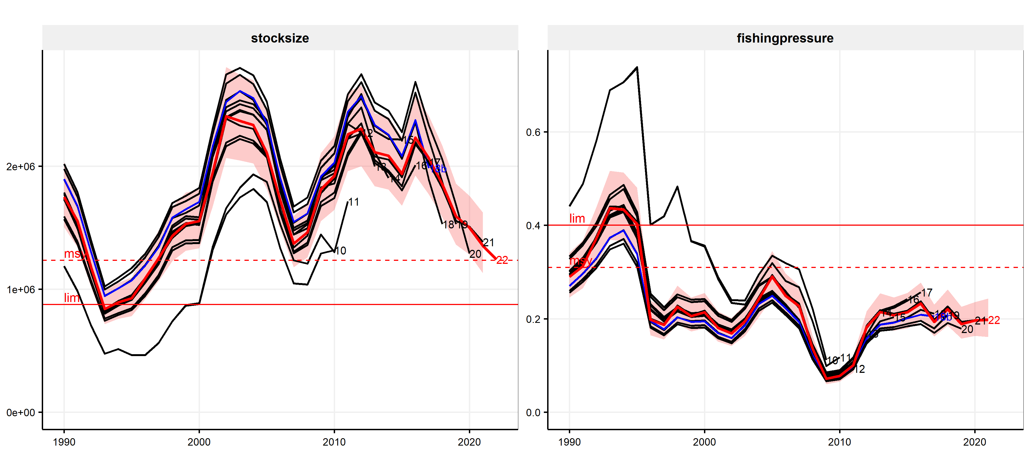
NS herring: some uncertainty in stock level

Slide 26
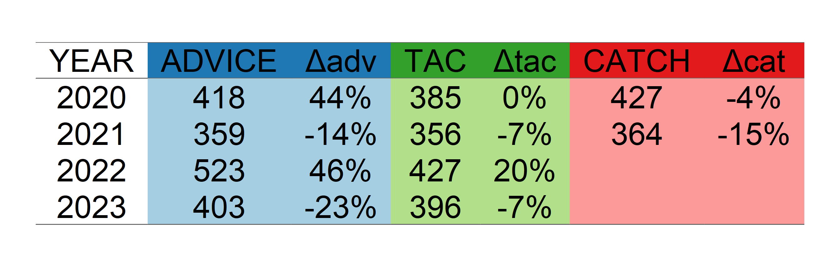
NS herring: 23% lower advice

Slide 27
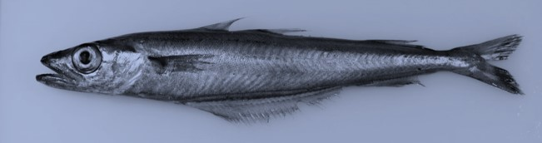
Blue whiting (WHB)

Slide 28
Key aspects of Blue whiting
Stable catching area
No agreement on sharing; substantial overshoot over advice
Stock increasing due to very strong recruitment
Relatively consistent assessment
Advice: 81% increase relative to 2022 advice

Slide 29
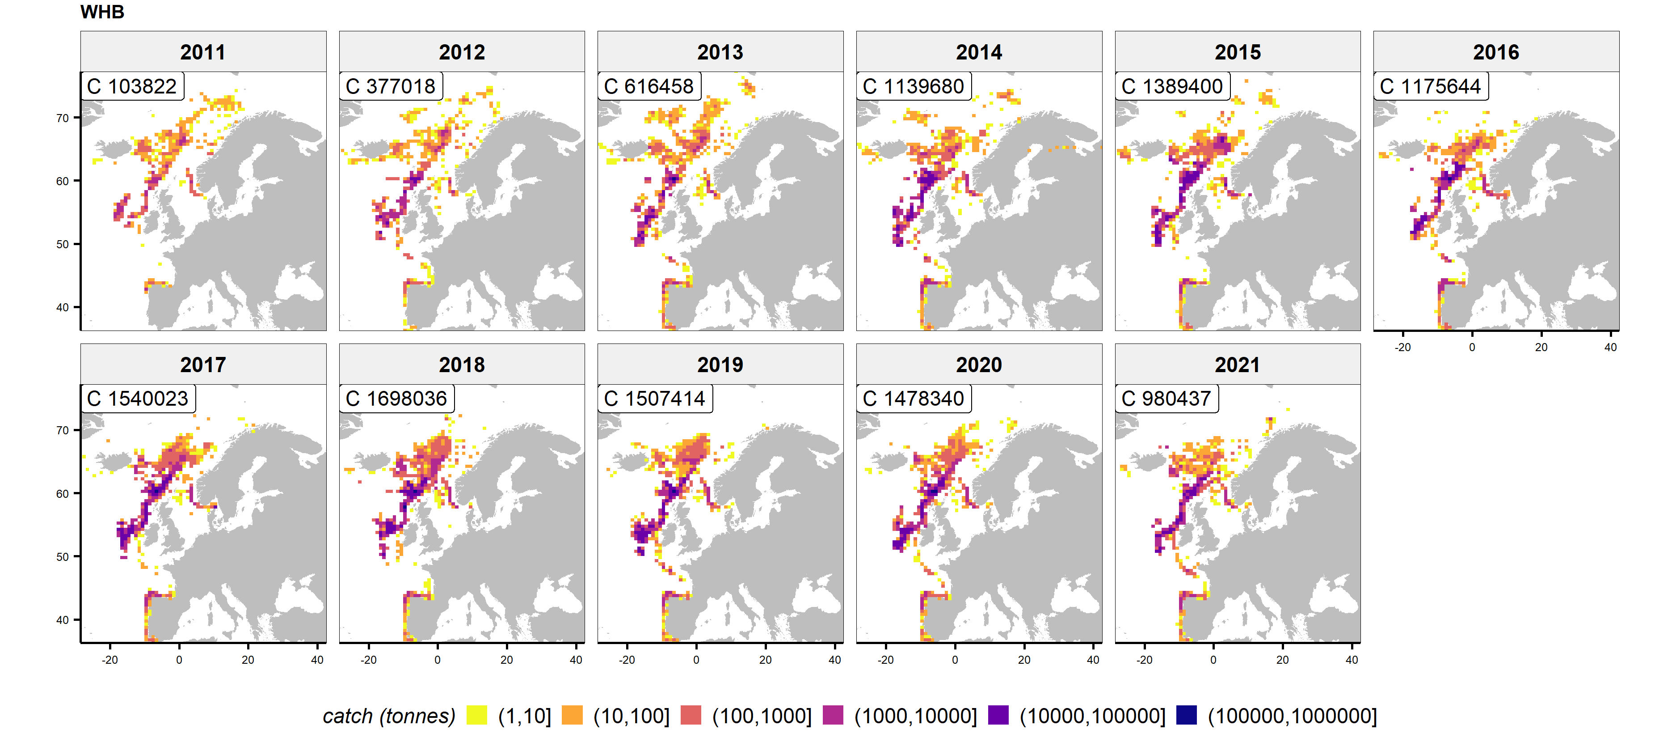
Blue whiting: stability in catching area

Slide 30
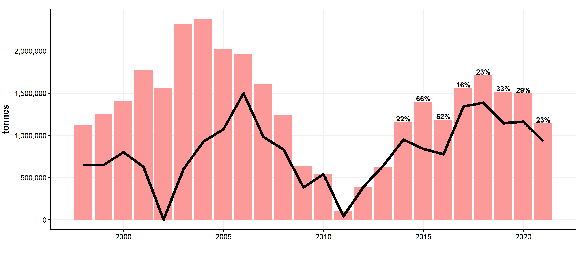
Blue whiting: overshoot of catches over advice

Slide 31
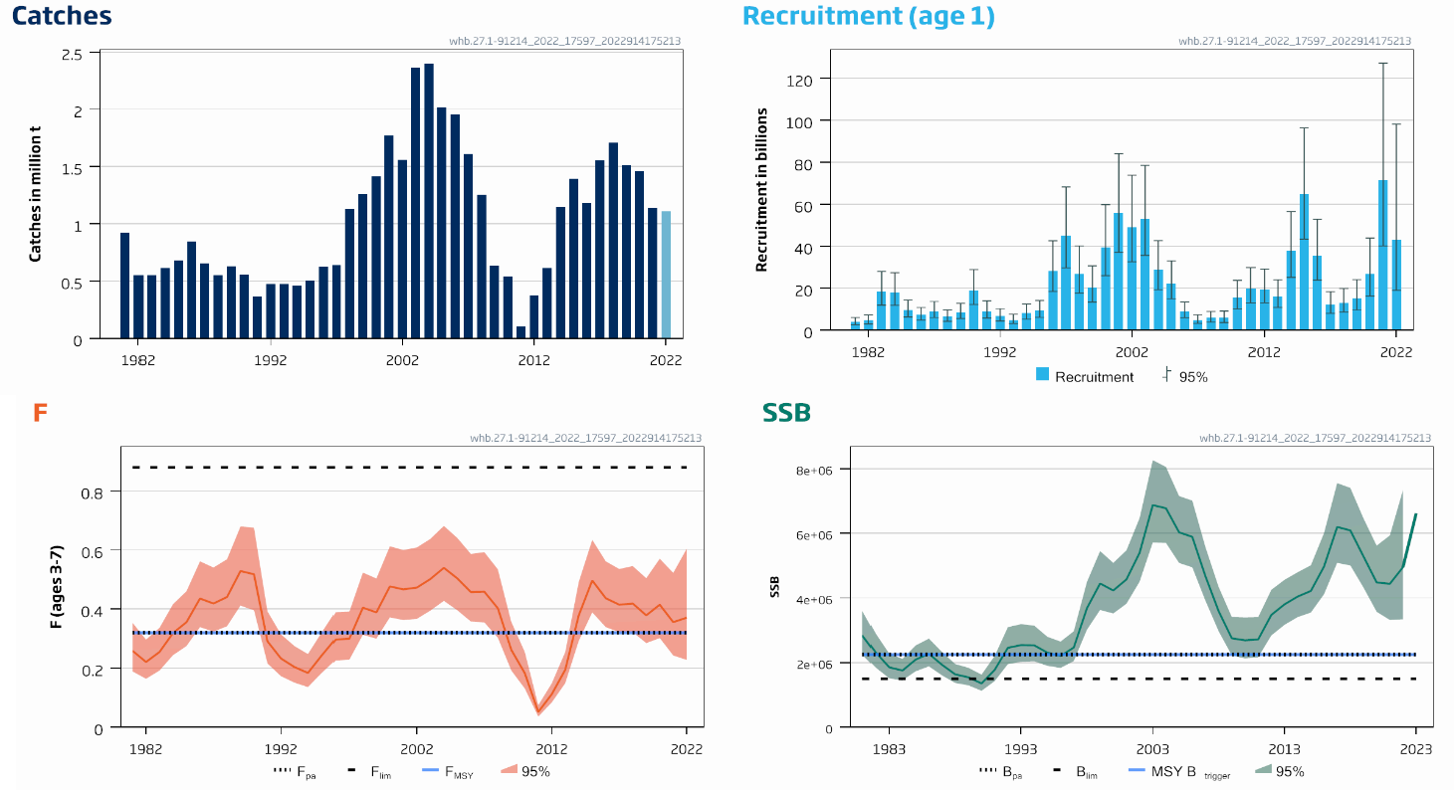
Blue whiting: very strong incoming recruitment

Slide 32
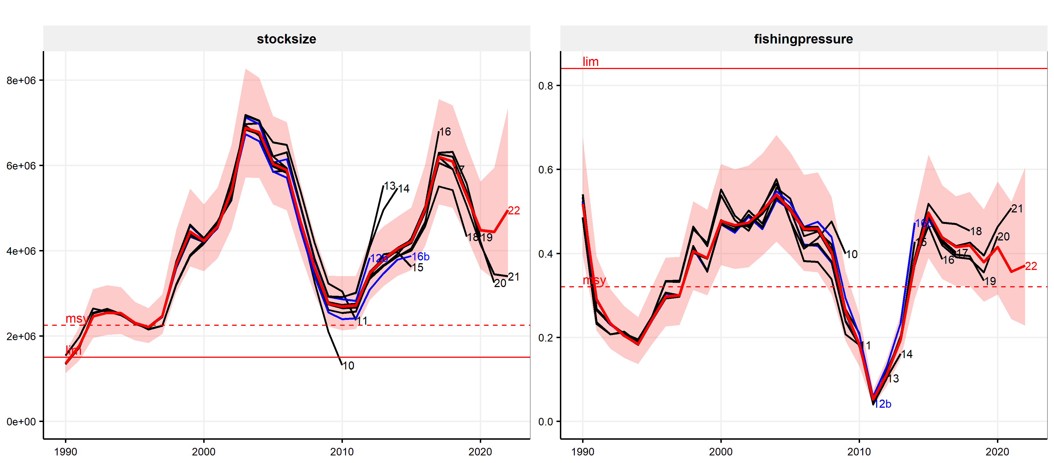
Blue whiting: relatively consistent assessment

Slide 33
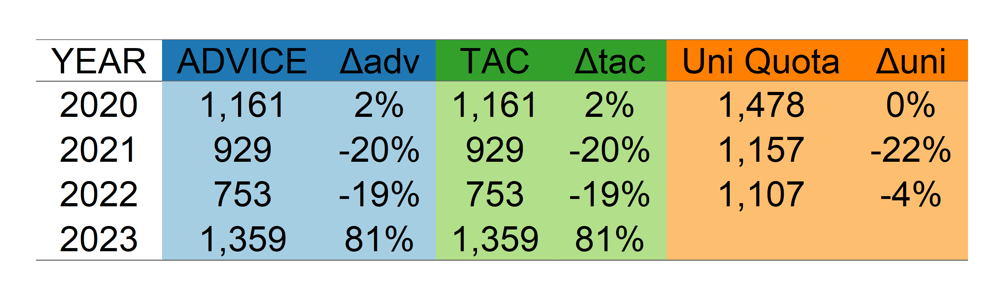
Blue whiting: strong increase in advice

Slide 34
Summary
Atlantic mackerel (MAC)
Scomber scombrus
Atlantic herring (HER)
Clupea harengus
Blue whiting (WHB)
Micromesistius poutassou

Slide 35
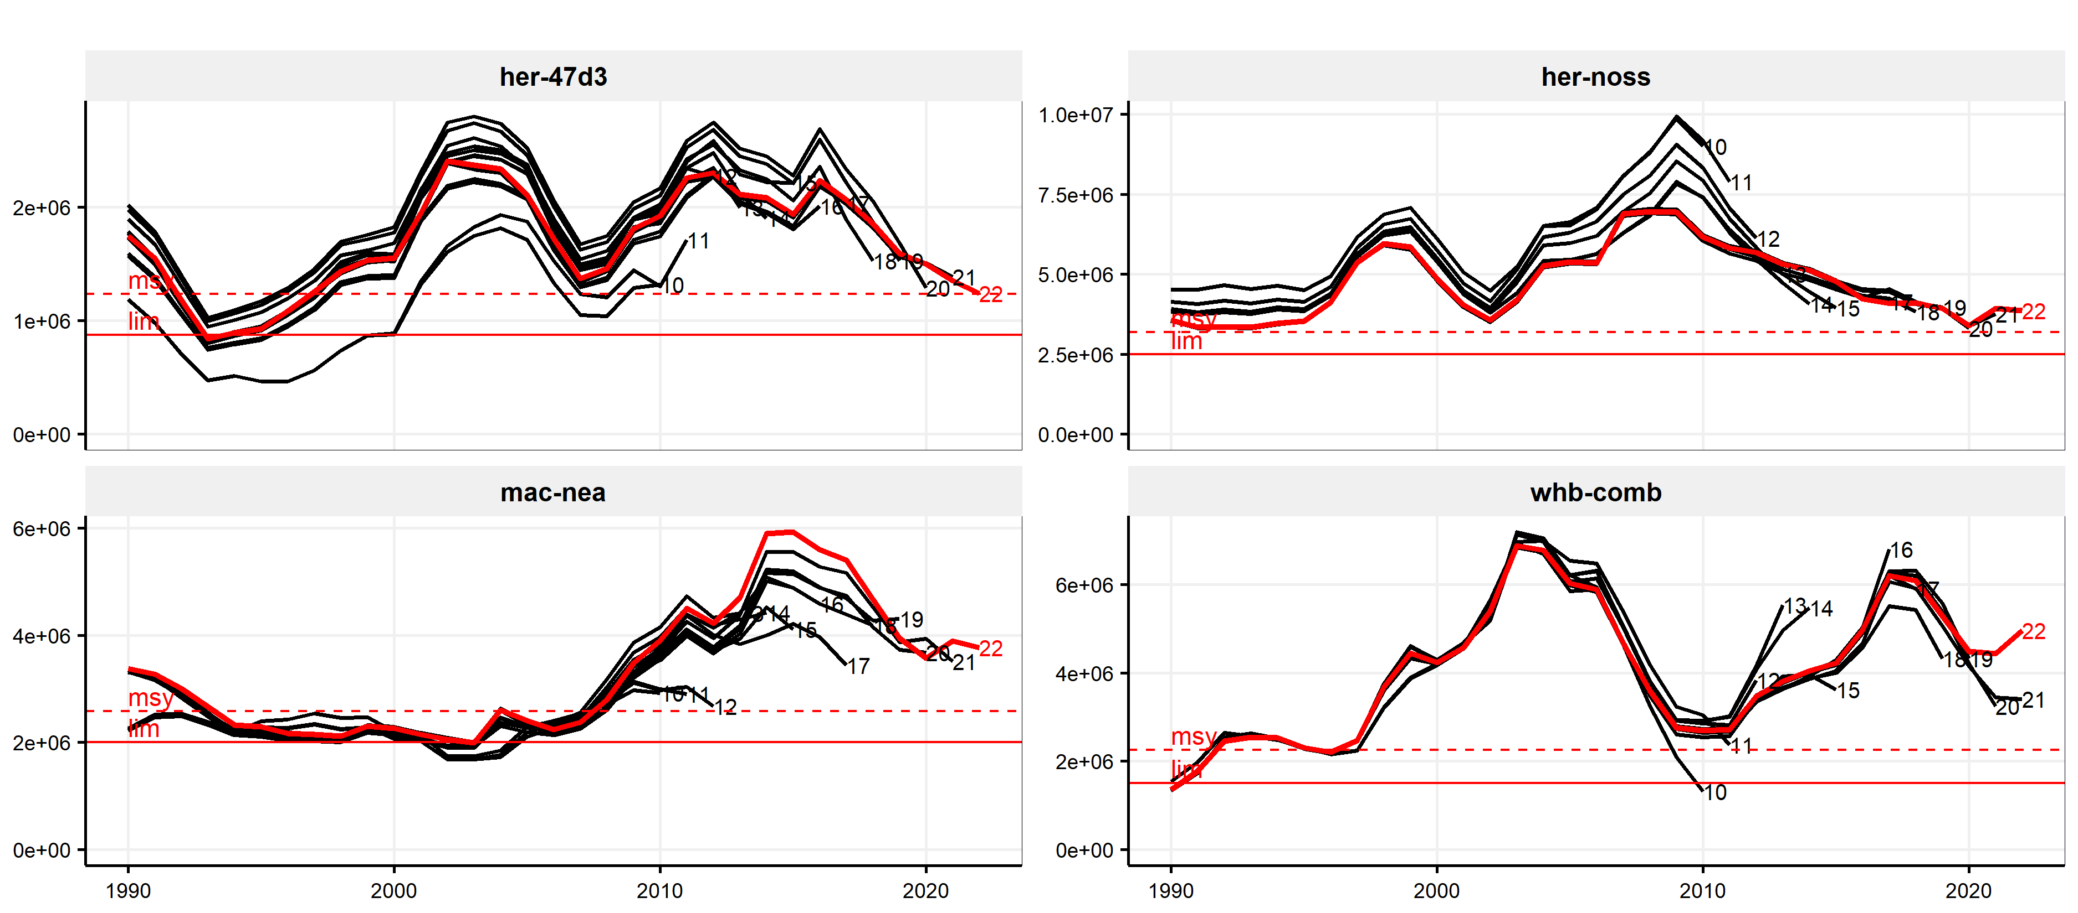
Pelagic assessments are uncertain/declining ...

Slide 36
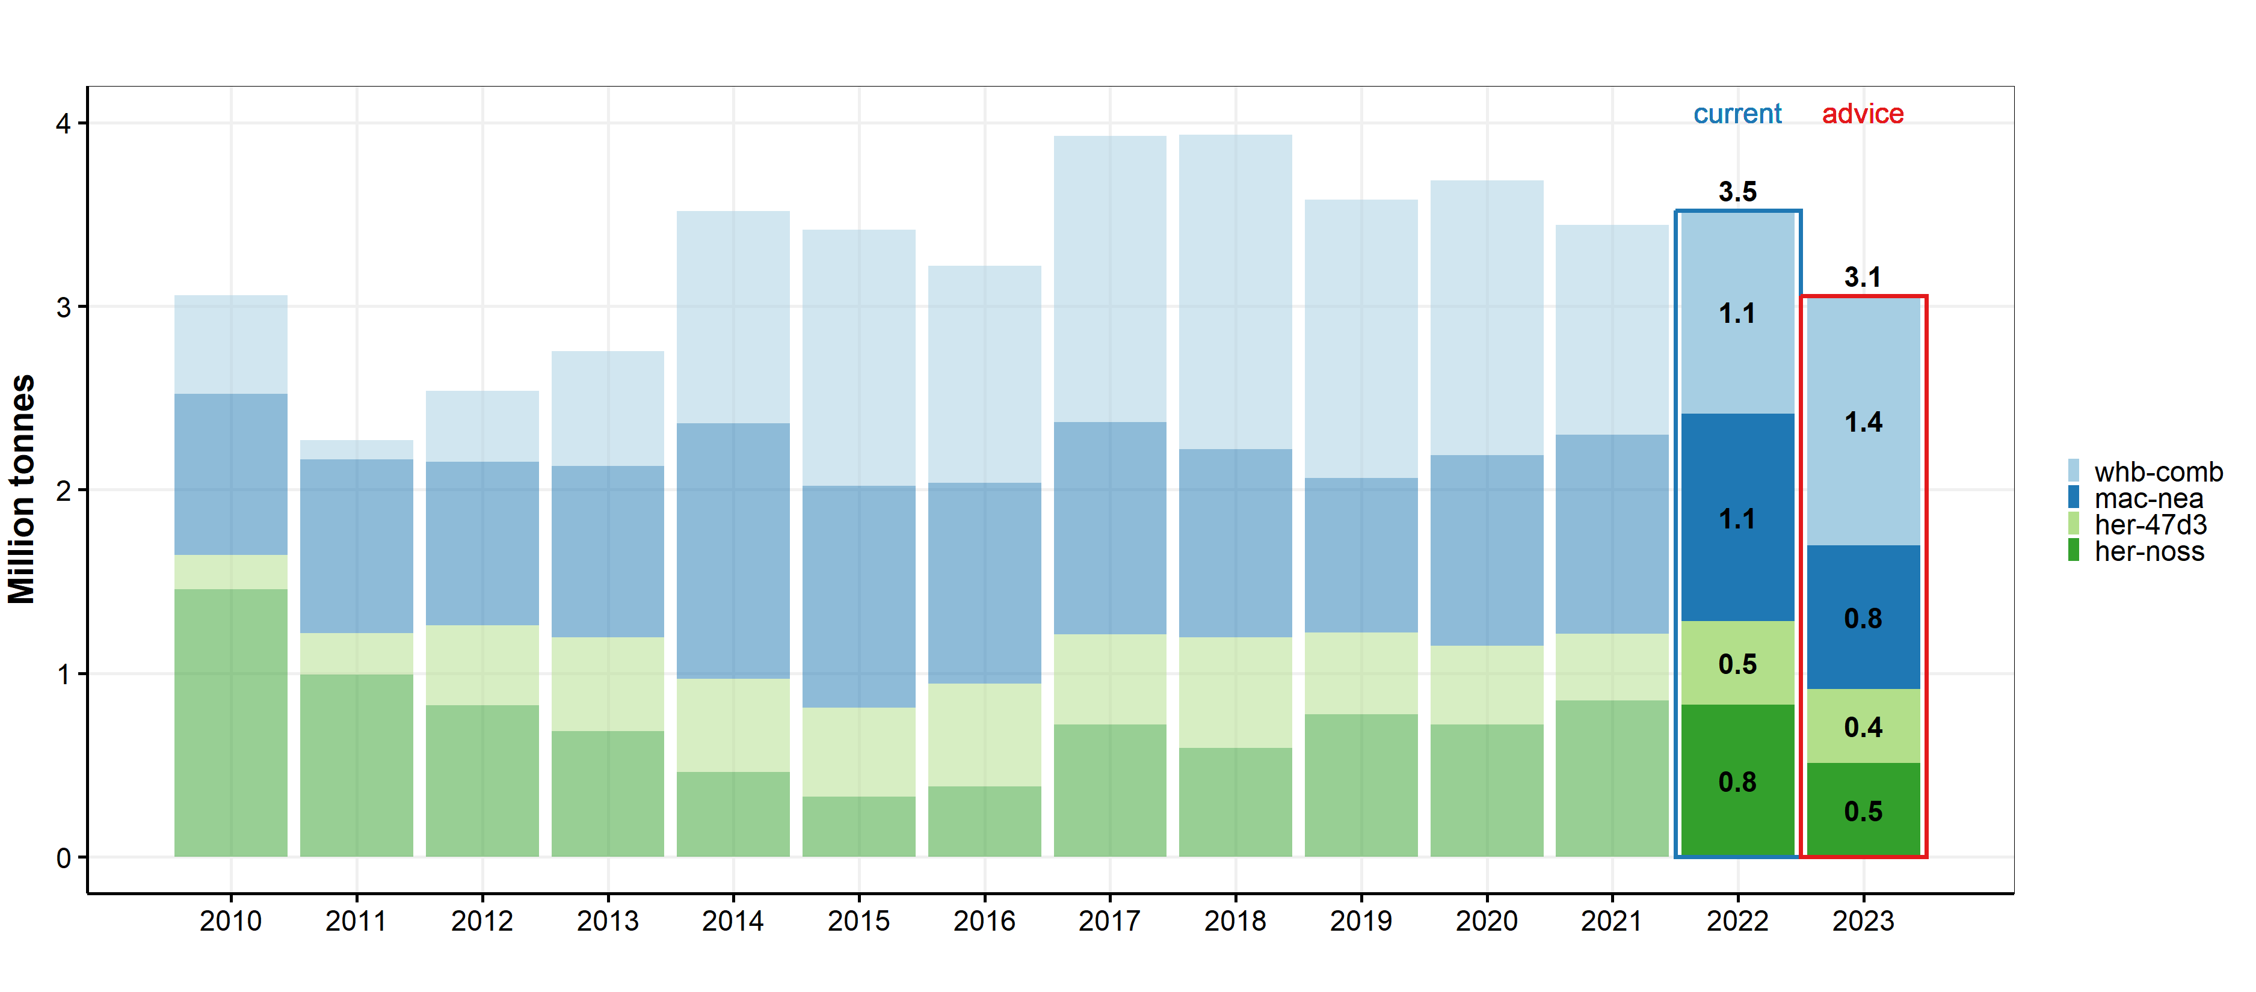
Increase in blue whiting, decrease others

Slide 37
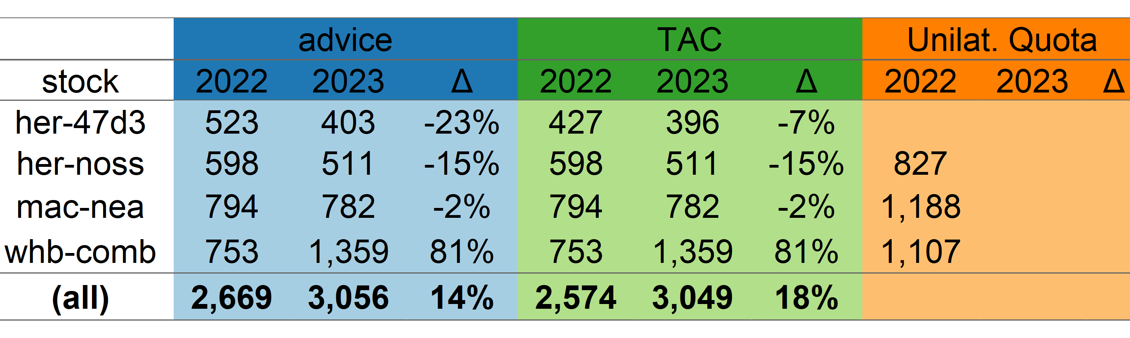
Pelagic stocks: increase in advice

Slide 38
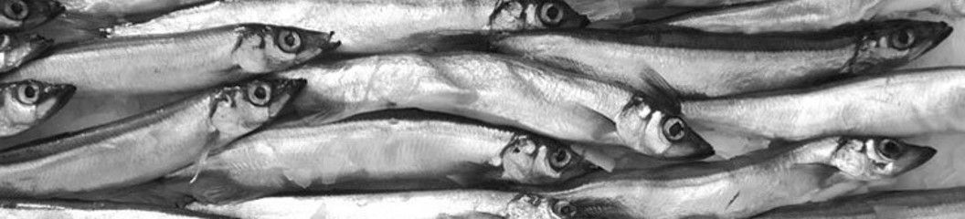
Capelin (CAP)

Slide 39
Key aspects of Capelin in the Northeast Atlantic
Two main capelin stocks
Capelin in subareas 1 and 2 (Northeast arctic)
Capelin in subareas 5 and 14 (Iceland, Greenland)
In-year management
Escapement advice: only fish when stock is above threshold

Slide 40
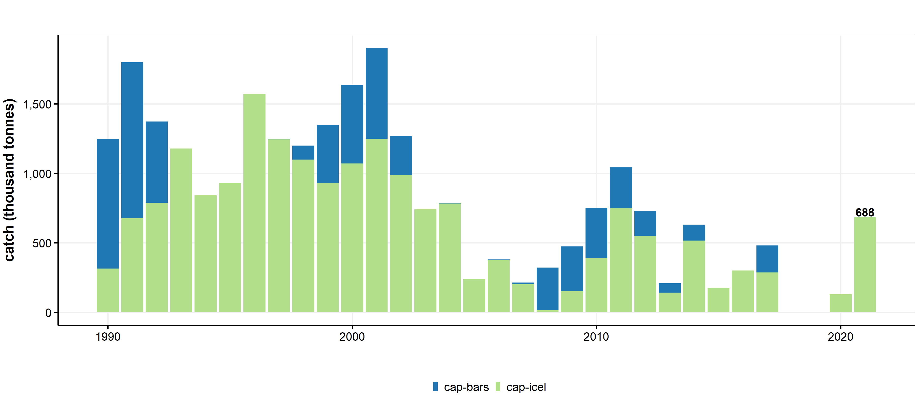
Capelin catches

Slide 41
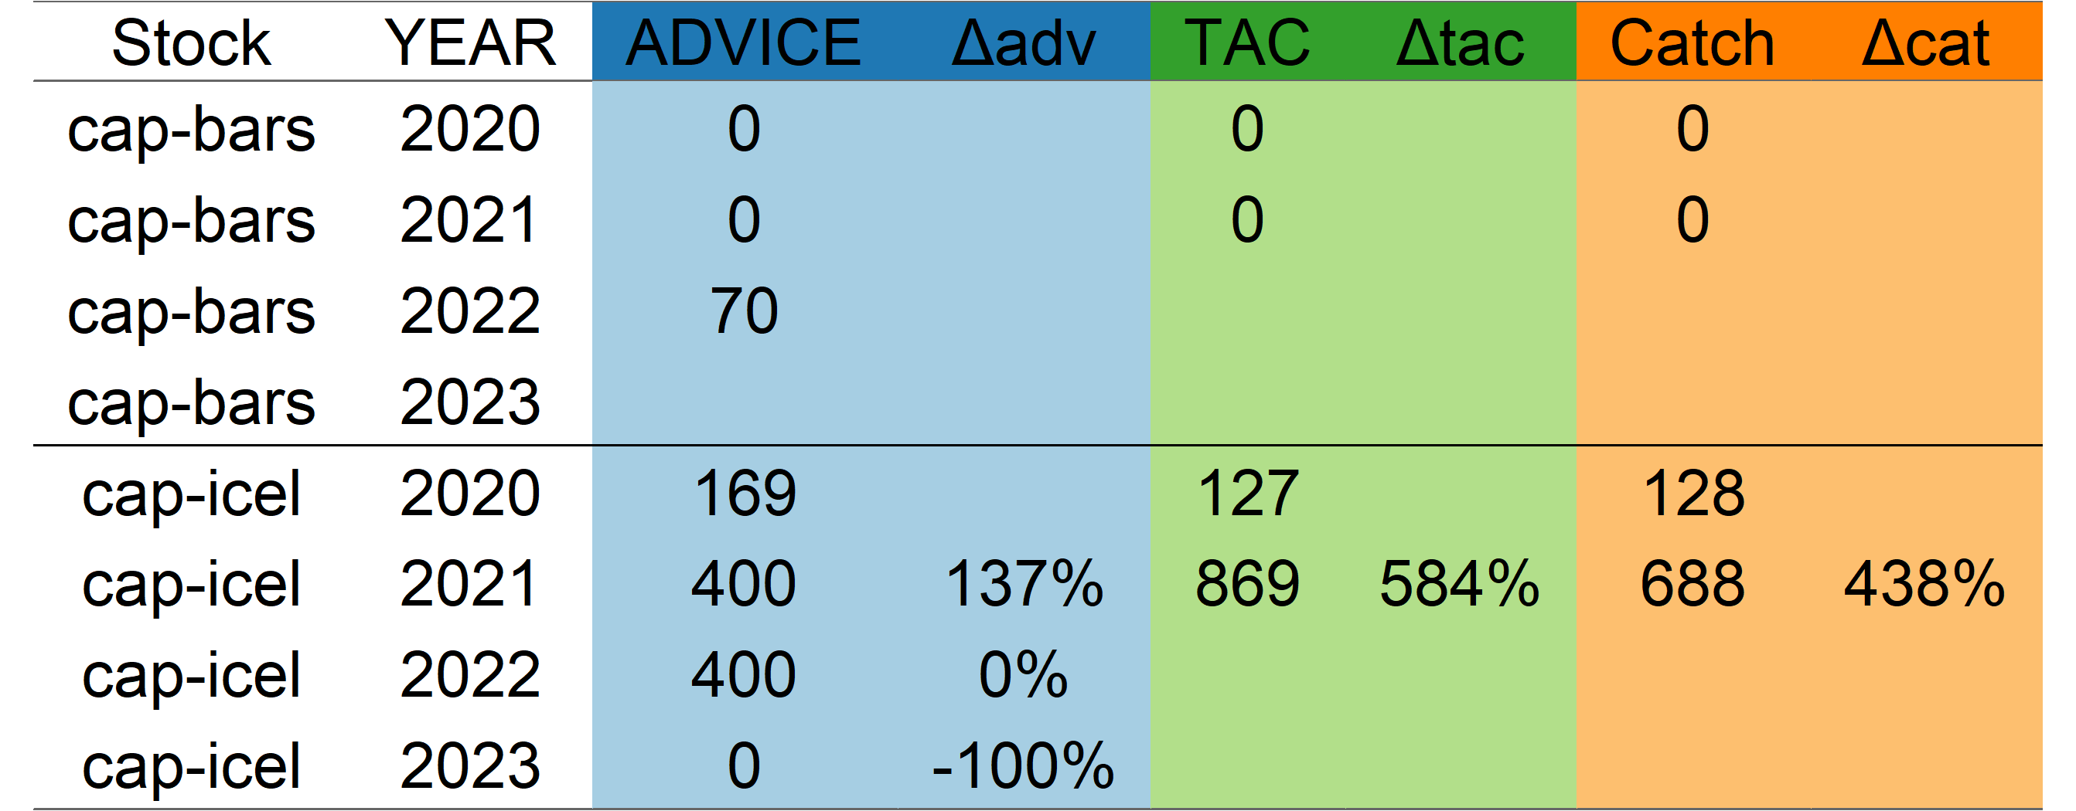
Capelin: recommendations overview

Slide 42
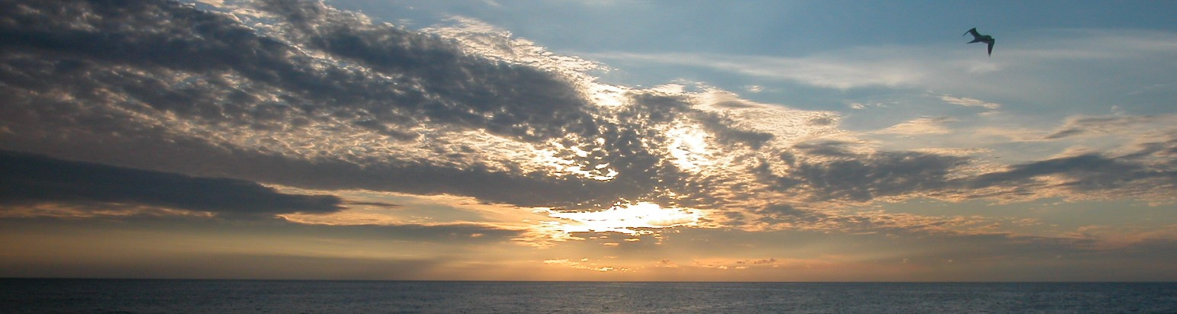
Thank you
martinpastoors@mpff.nl

